Slide 1
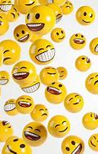
World Happiness
Beth Myers, Jared Nieves, Matthew O’Donnell, Zack Rogers, and Darrius Summers

Slide 2
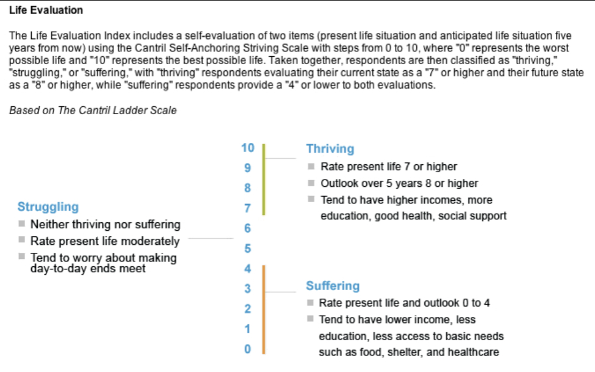
Background
Formally began publication in 2012
Based upon data gathered from the Gallup World Poll
Approximately 1,000 people were surveyed in each country
Use of the Cantril ladder to measure “Happiness”
(rating of 0 to 10, where 0 was deemed struggling and 10 is deemed thriving)

Slide 3
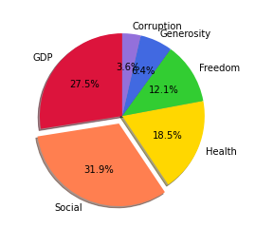
The Data at a glance
There are 6 components which have been used to determine “Happiness”
GDP
Social Support
Healthy life expectancy
Freedom to make life choices
Generosity
Perceptions of Corruption

Slide 4
Initial analysis
Selection of 2015 through 2019
Some Countries required renaming (example: Trinidad & Tobago vs. Trinidad and Tobago)
Instances where each country was not included in all years, which may create some limitations

Slide 5
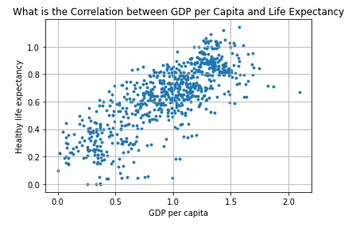

What did we learn…
The correlation coefficient between GDP Per Captia and Healthy Life Expectancy is 0.78

Slide 6
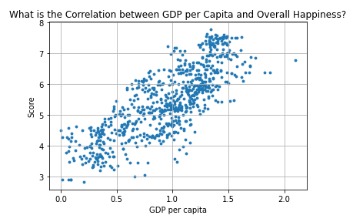
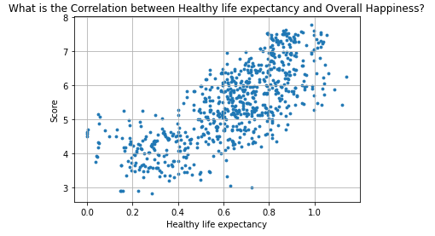

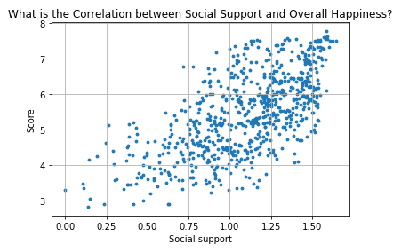
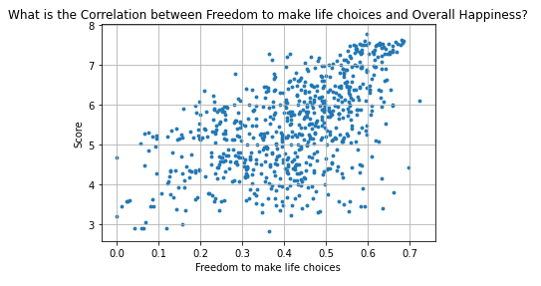
The correlation coefficient between GDP Per Captia and Score is 0.79
The correlation coefficient between Healthy life expectancy and Score is 0.74
The correlation coefficient between Social Support and Score is 0.65
The correlation coefficient between Freedom to make life choices and Score is 0.54

Slide 7

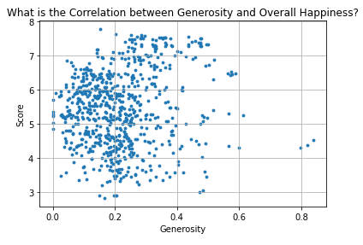
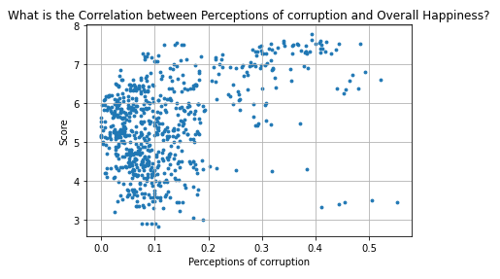

The correlation coefficient between Generosity and Score is 0.14
The correlation coefficient between Perceptions of corruption and Score is 0.42

Slide 8
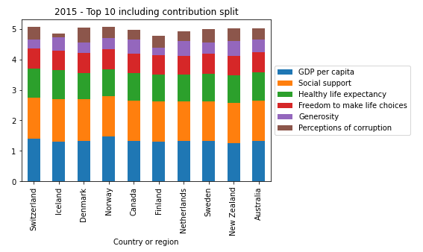
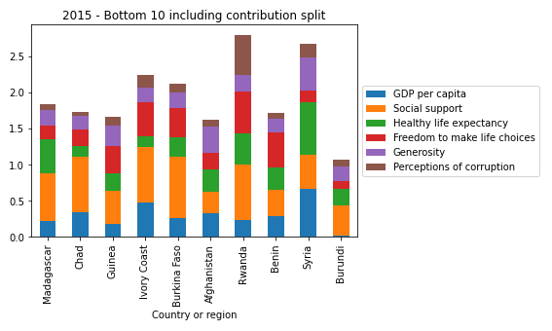
2015
Comparison of Top 10 and Bottom 10

Slide 9
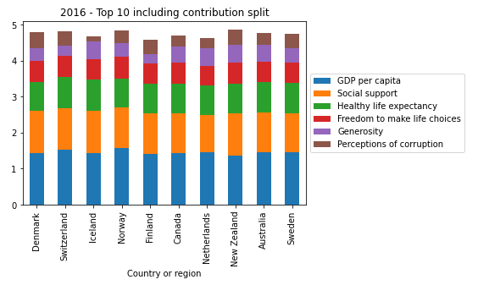
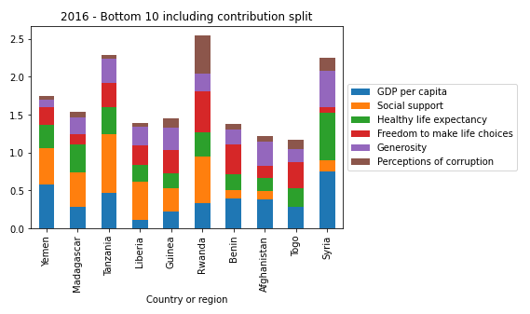
2016
Comparison of Top 10 and Bottom 10

Slide 10
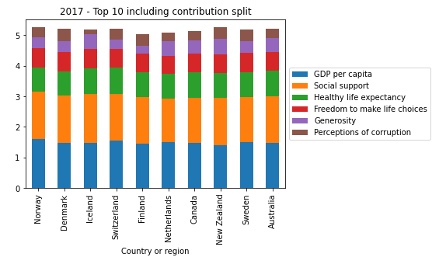
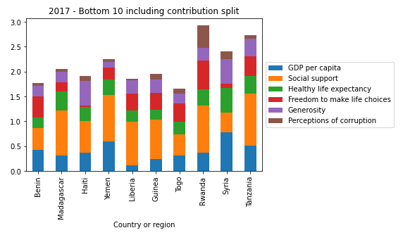
2017
Comparison of Top 10 and Bottom 10

Slide 11
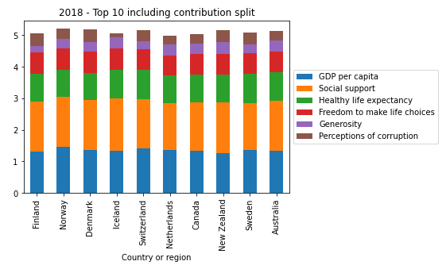
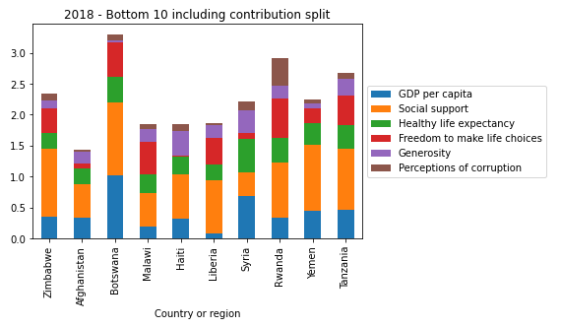
2018
Comparison of Top 10 and Bottom 10

Slide 12
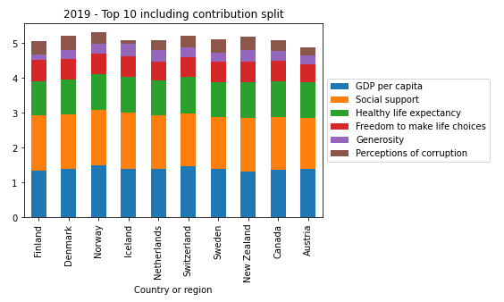
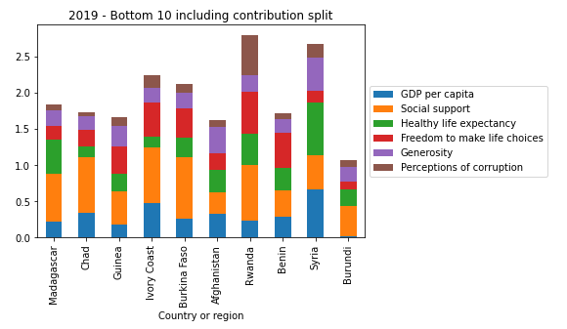
2019
Comparison of Top 10 and Bottom 10

Slide 13
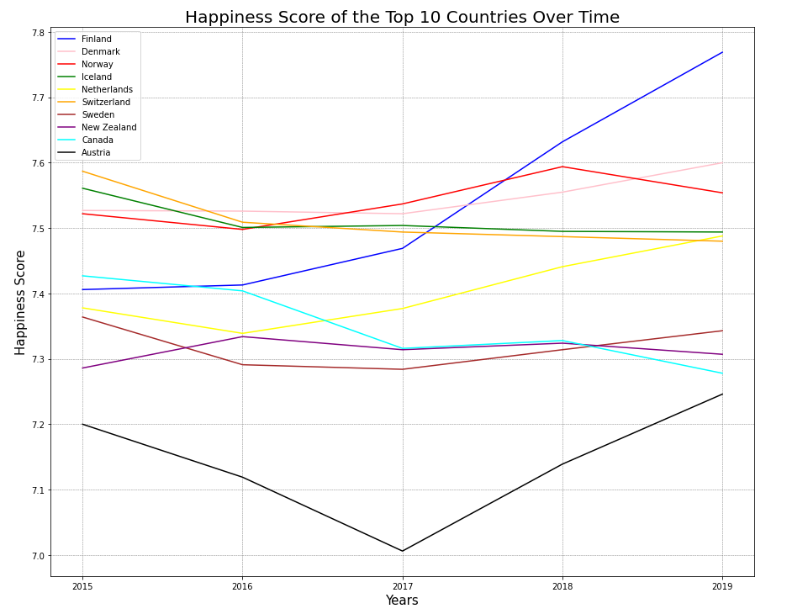
Happiness Over Time – Top 10

Slide 14
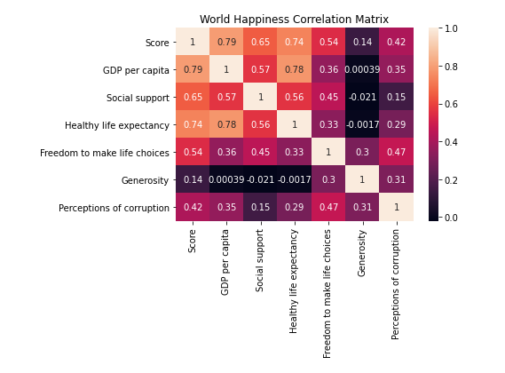
Correlation map

Slide 15

Conclusion
Any Questions?

